Slide 1
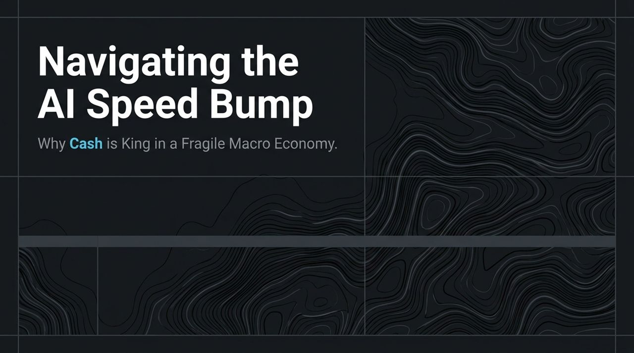
Notes:
Welcome everyone. Today, we are taking a deep dive into the current macroeconomic environment and the tech sector landscape, drawing key tactical insights from market analyst Dan Niles.
As the title suggests, we are navigating what we view as an "AI Speed Bump"—a temporary, healthy consolidation period rather than a structural bubble burst. However, this tech pause is coinciding with severe macroeconomic fragility.
Over the next several slides, we will break down why 65 months of elevated inflation are forcing the Federal Reserve's hand, examine four critical macroeconomic "torpedoes" on the horizon, evaluate the true state of AI unit economics and model deployment, and explain why cash and money market funds serve as the ultimate tactical safe haven through the upcoming midterm election period.
https://www.youtube.com/watch?v=BzVoaQ9doTU

Slide 2
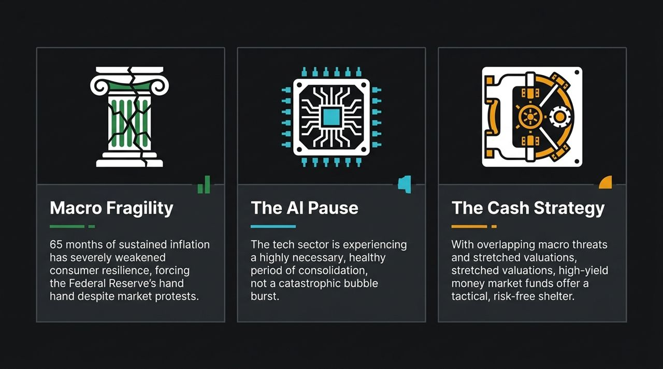
Notes:
To frame our overall narrative, we look at three core pillars currently dictating global market performance:
Macro Fragility: We have experienced 65 consecutive months of above-target inflation. This has severely depleted the financial resilience of average consumers. Regardless of market pushback, the Federal Reserve's primary responsibility is to control inflation, making monetary tightening or sustained high rates an inevitability.
The AI Pause: In the technology space, market participants are panicking over recent pullbacks. We want to clarify that this is a highly necessary consolidation phase. It gives hyperscalers room to evaluate capital expenditures rather than blindly engaging in a race to the bottom.
The Cash Strategy: When you combine overlapping macro threats, high bond yield volatility, and stretched equity valuations, high-yield money market funds offer an attractive, risk-free tactical shelter while we wait for market clarity.

Slide 3
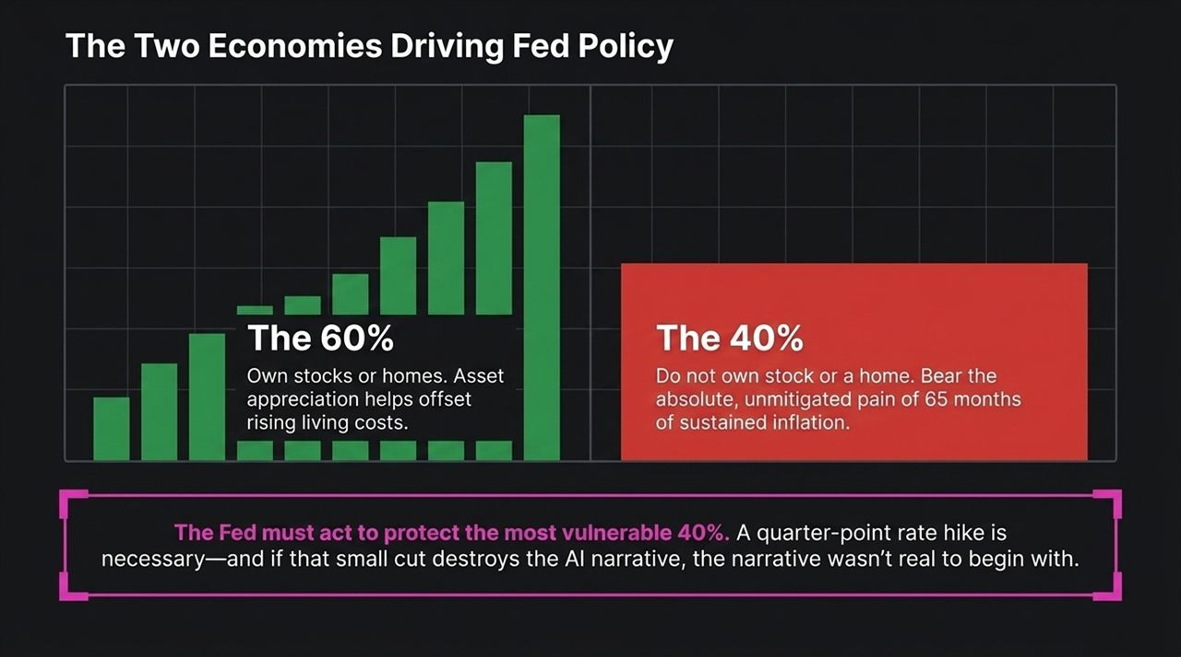
Notes:
To understand why Fed Chair Powell and central bankers must remain hawkish, you have to realize that the United States is operating as two distinct economies:
The 60%: About 60% of US households own stocks or residential real estate. For this group, asset price inflation—rising stock portfolios and home values—acts as a balance sheet buffer against the rising cost of living.
The 40%: The remaining 40% of households own no equities and no home. They bear the unmitigated pain of 65 months of compounding inflation. Every price increase at the grocery store, gas pump, or utility bill directly erodes their standard of living without any asset appreciation offset.
Central banks cannot formulate policy solely for Wall Street. The Fed's mandate requires protecting the most vulnerable 40%. If a rate hike or sustained high rates dampens tech valuations, that is a necessary trade-off. As Dan Niles notes: if a minor rate adjustment destroys the AI story, then the AI story was never real to begin with.

Slide 4
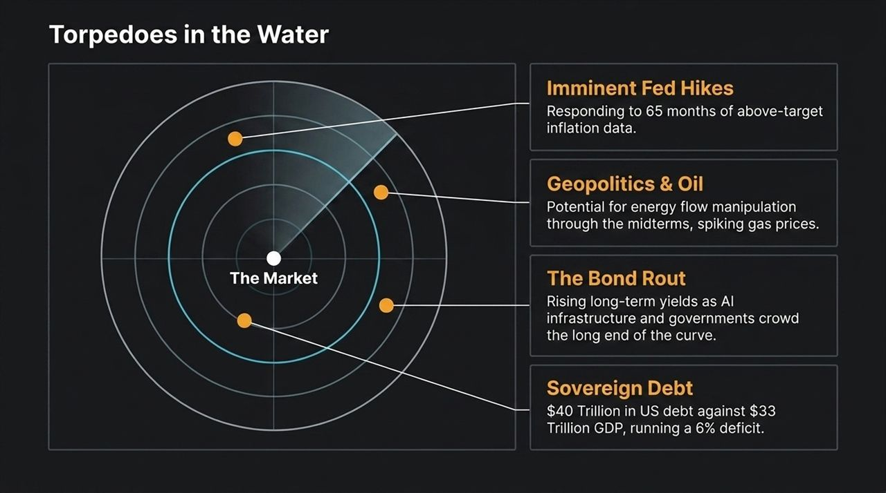
Notes:
When looking at equity markets today, we see four major "torpedoes in the water" that create significant downside risk:
Imminent Fed Hikes / Hawkish Stance: With 65 months of sticky inflation data, the Fed cannot afford to ease aggressively and may be forced to hike.
Geopolitics & Oil: Unrest in key shipping lanes (like the Strait of Hormuz) and political posturing ahead of elections threaten to keep energy prices elevated, driving headline inflation right back into consumer pocketbooks.
The Bond Rout: Long-term yields are backing up worldwide. AI data center infrastructure needs massive financing at the exact time sovereign governments are flooding the market with debt issuances, crowding out the long end of the curve.
Sovereign Debt Burden: The US is carrying over $40 Trillion in debt against a ~$33 Trillion GDP while running an unsustainable 6% deficit during an expansionary period. Global bond markets are demanding higher risk premiums across the board.

Slide 5
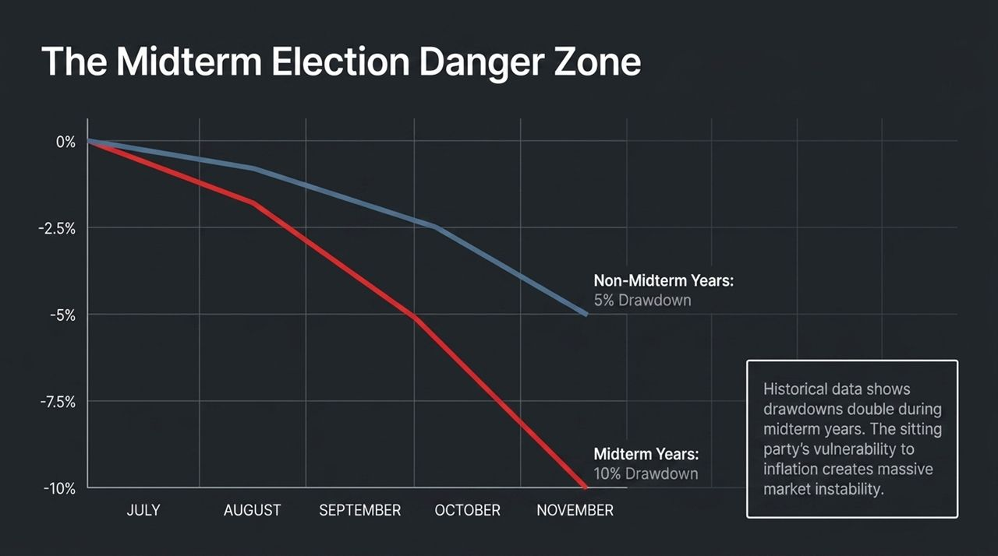
Notes:
Adding seasonal and historical context to our macro warnings: we are entering the midterm election danger zone.
Historical market data from 1990 to present shows a clear seasonal pattern between late July and early November:
In standard, non-midterm years, the average broad market drawdown from peak to trough is approximately 5%.
In midterm election years, that drawdown doubles to an average of 10%.
Why does this happen? The sitting political party is acutely vulnerable to consumer dissatisfaction over inflation and gas prices. Political uncertainty combined with hawkish policy setups creates heightened volatility and sharp market pullbacks.

Slide 6
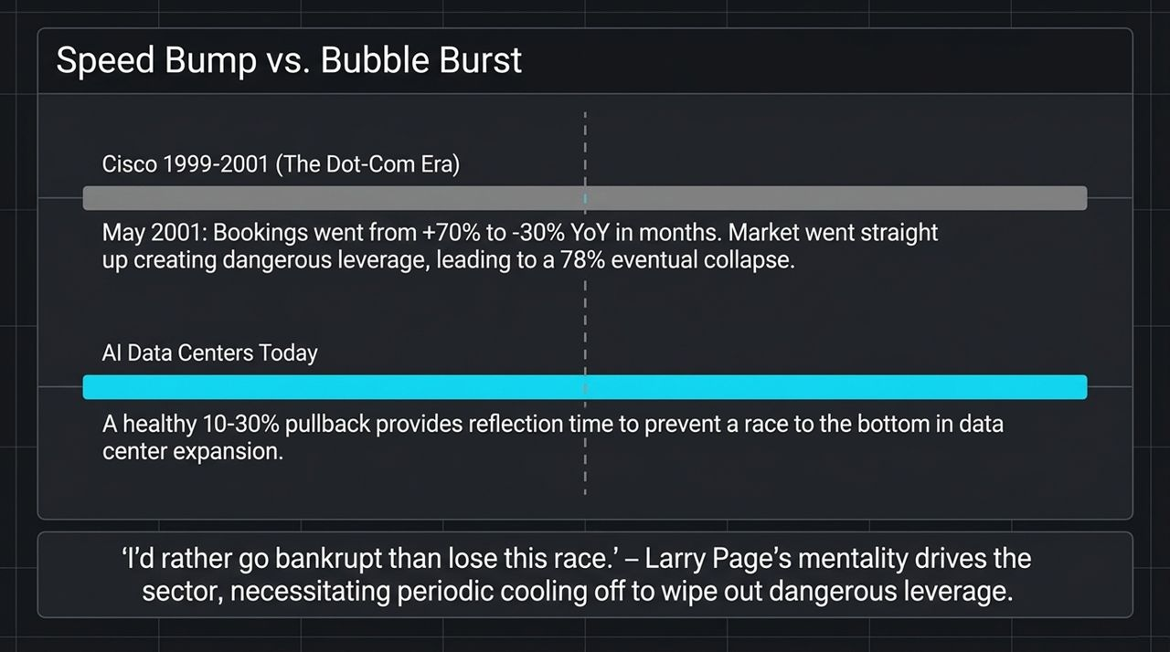
Notes:
Many commentators are drawing parallels between current AI infrastructure spending and the 2000 Dot-Com crash. Let’s examine why this comparison is flawed:
Cisco (1999–2001): During the Dot-Com bubble, Cisco's order bookings swung from +70% YoY to -30% YoY in a matter of months. Excessive leverage and pure speculation pushed the NASDAQ up exponentially, leading to an eventual 78% collapse.
AI Data Centers Today: What we are seeing today is a healthy 10% to 30% pullback, not a structural collapse. Tech leaders often adopt the Larry Page mentality: "I'd rather go bankrupt than lose this race."
Left unchecked, this aggressive capex leads to overbuilding. A market speed bump forces management teams to pause, evaluate efficiencies, and eliminate dangerous financial leverage before it turns into a catastrophic bubble.

Slide 7
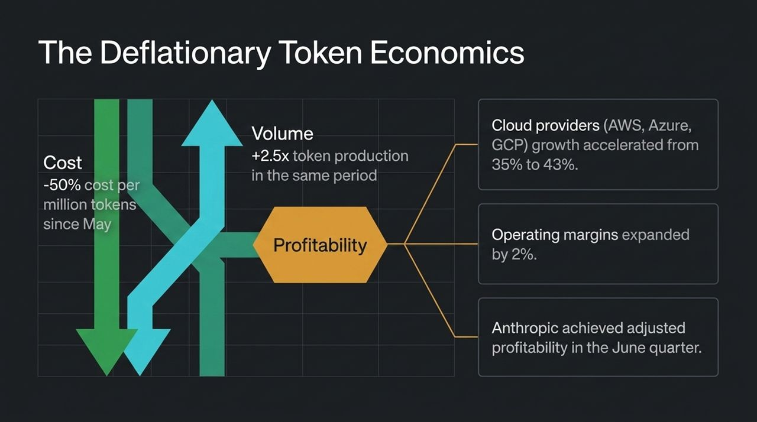
Notes:
To see why the fundamentals of AI remain strong despite price cuts, look at token economics:
Since May, the cost per million tokens has dropped by over 50% due to open-weight models and algorithmic optimization. Bearish analysts point to this unit price decline as evidence of margin compression.
However, demand elasticity has completely offset price drops: token production volume grew +2.5x over the same timeframe.
Look at cloud providers (AWS, Azure, Google Cloud): revenue growth accelerated from 35% to 43% YoY, while operating margins actually expanded by 2%. Furthermore, Anthropic achieved adjusted profitability in the June quarter. Unit costs are dropping, usage is surging, and bottom-line margins are expanding.

Slide 8
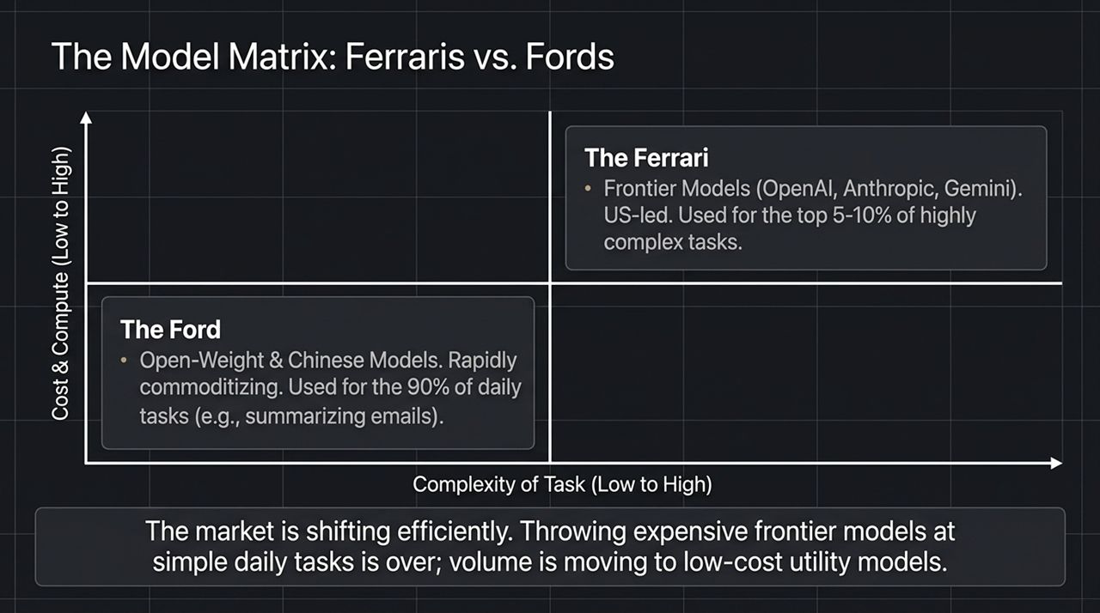
Notes:
The AI model landscape is bifurcating efficiently into two clear categories:
The Ferraris (Frontier Models): High-cost, massive compute models developed by US leaders like OpenAI, Anthropic, and Google (Gemini). These are expensive to run and should be reserved for the top 5–10% of highly complex reasoning and enterprise tasks.
The Fords (Utility & Open-Weight Models): Rapidly commoditizing models, including Chinese open-weight solutions. These low-cost, fast models handle the remaining 90% of everyday workflows—such as summarizing emails or basic data sorting.
Early on, enterprises made the mistake of driving "Ferraris to the grocery store" for simple tasks. The market is now right-sizing, directing bulk volume to low-cost utility models while preserving frontier models for complex problems.

Slide 9
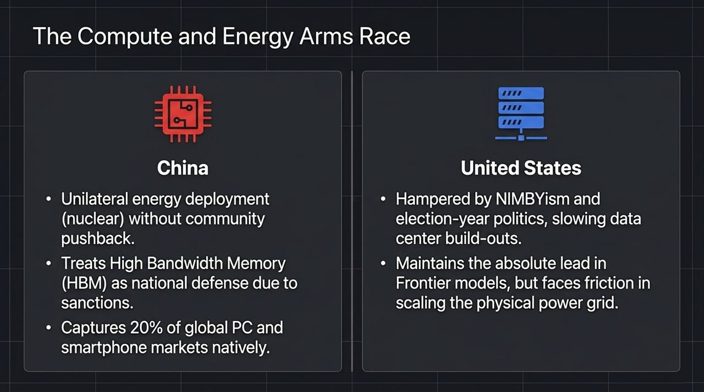
Notes:
The global competition in AI infrastructure comes down to power grid scaling and hardware supply chains:
China's Position: Facing US export sanctions, China treats High Bandwidth Memory (HBM) and domestic chip production as critical national defense priorities. Their centralized government allows unilateral nuclear and energy deployment for data centers without local pushback. Plus, domestic consumption (20% of global PC and smartphone markets) guarantees an immediate market for their chips.
United States' Position: The US maintains an absolute lead in frontier software models. However, physical data center expansion is increasingly slowed by local NIMBYism, regulatory delays, and power grid constraints during an election year.

Slide 10
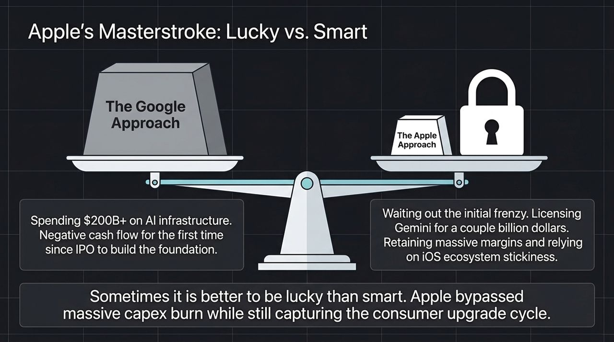
Notes:
A compelling corporate strategy contrast in the AI space is Google versus Apple:
The Google Approach: Spending $200B+ on physical AI infrastructure, resulting in negative free cash flow for the first time since their IPO to establish foundational dominance.
The Apple Approach: Apple delayed massive internal capex builds and instead chose to license Gemini and external frontier models for a fraction of the cost.
While Apple was late on native model generation, their massive iOS installed base gives them distribution dominance and sticky ecosystem lock-in. As the saying goes, "Sometimes it is better to be lucky than smart." Apple captured consumer AI integration while preserving balance sheet margins.

Slide 11
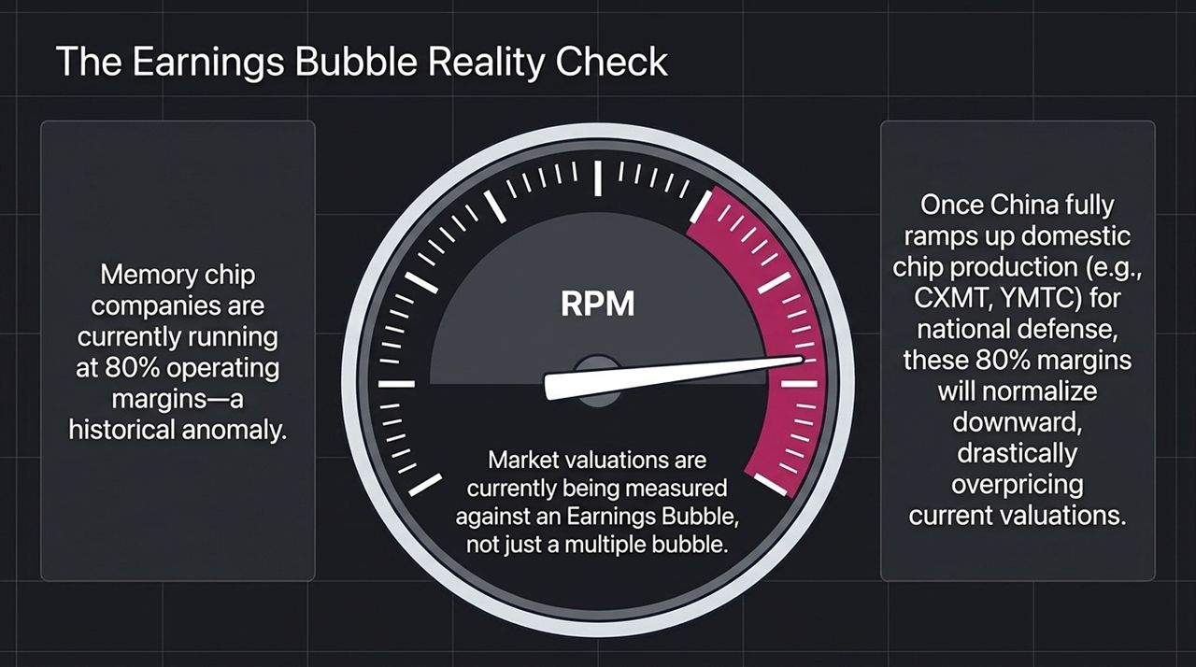
Notes:
When assessing market valuations, investors must look beyond multiple expansion and evaluate normalized earnings:
Currently, leading memory chip manufacturers are generating ~80% operating margins. In semiconductor history, 80% margins during a capex buildout are a cyclical anomaly, not a permanent baseline.
As China ramps up domestic production capacity (through players like CXMT and YMTC) for national defense self-sufficiency, global memory supply will surge. High operating margins will eventually normalize downward. Valuations priced against peak "Earnings Bubble" numbers leave equities vulnerable to repricing.

Slide 12
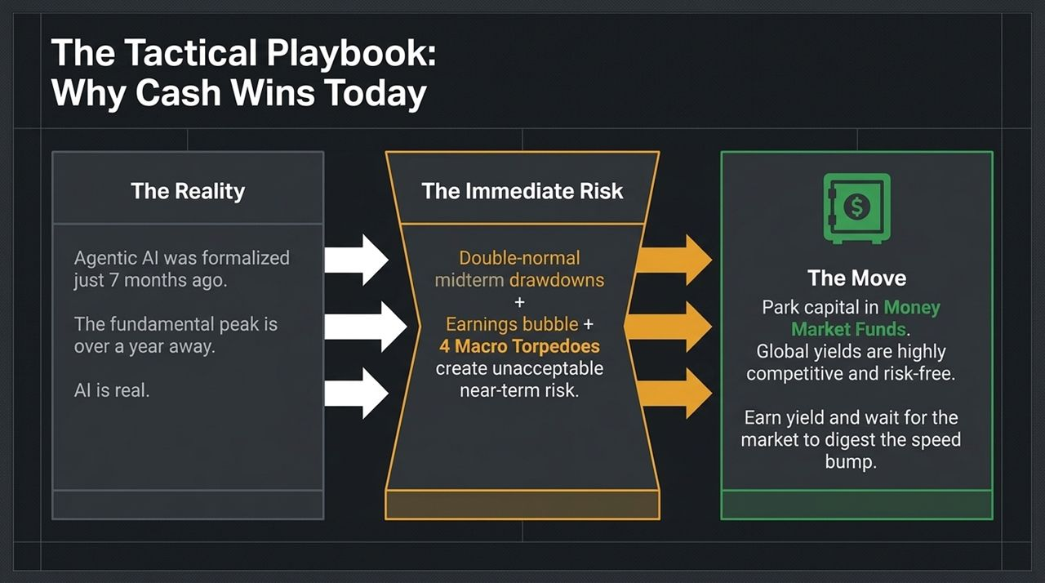
Notes:
Let's synthesize the fundamental reality, immediate risks, and key tactical playbook moves:
The Fundamental Reality: Agentic AI frameworks only emerged ~7 months ago. The fundamental secular peak for AI growth is still over a year away. AI technology is real and transformative.
The Immediate Risk: Double-normal midterm drawdowns (10%), inflated earnings multiples, elevated long-end bond yields, and macro headwinds create unacceptable short-term risk.
The Move: Park tactical capital in Money Market Funds. Global yields are competitive and risk-free. As Dan Niles stated: "With these risks in front of me, the only safe thing right now is sitting in cash."

Slide 13

Notes:
Slide 13 provides an executive overview summarizing Dan Niles’ core thesis across three dimensions:
Macro Torpedoes & Fragility: 65 months of above-target inflation hurt the lower 40% of households. The Fed must prioritize price stability, leading to hawkish policy shifts.
AI Outlook: Agentic AI is only 7 months into its cycle, pointing to sustained growth over the next 12–18 months. Declining token costs combined with 2.5x volume expansion demonstrate strong underlying unit economics.
Where to Take Shelter: Midterm election quarters average a 10% market drawdown. With stock and bond markets facing concurrent risks, money market cash yields offer an effective risk-free yield buffer.

Slide 14
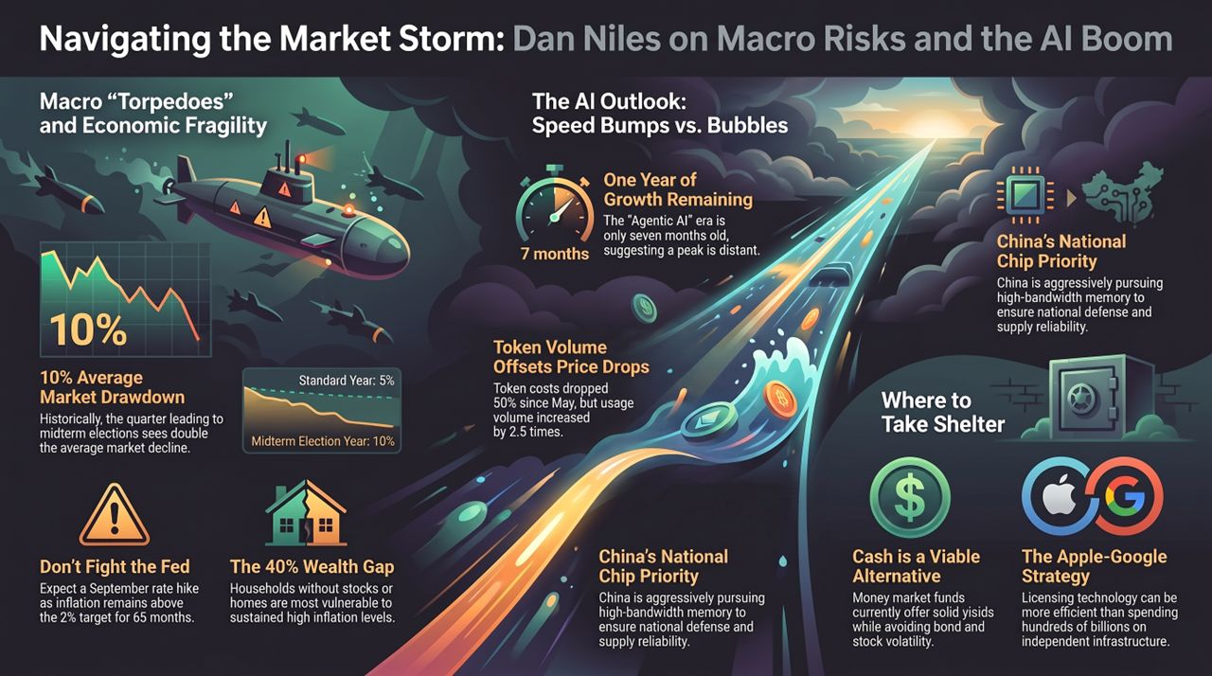
Notes:
To conclude our presentation, here are the key operational conclusions:
Respect the Market: Do not fight a hawkish Federal Reserve when inflation expectations remain unanchored.
Separate Secular Growth from Short-Term Volatility: AI technology is fundamentally sound and driving structural enterprise efficiency, but near-term valuations require digesting an earnings speed bump.
Embrace Tactical Liquidity: Cash is no longer a drag on portfolio return. Locking in risk-free yield while keeping dry powder ready allows investors to capitalize on a 10%+ midterm market pullbacks.
Thank you for your time, and I am happy to open the floor to Q&A.

